Slide 1
The Clean River Kent Campaign 2022 achievements 2023 aspirations
Sedgwick PC: 8 March 2023
Notes:
Thanks to our generous supporters!
Explain purpose of Open Event – launch our campaign in public, recruit volunteers for summer programme, get stakeholder support, etc.

Slide 2
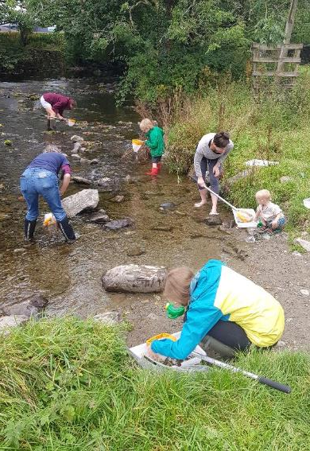
WHO WE ARE
A coalition of communities living along the River Kent, in Staveley, Burneside and Kendal.
Established in Autumn 2021.
WHAT WE WANT TO DO
To keep the River Kent clean for water-based recreation and to protect ecology and wildlife.

Slide 3
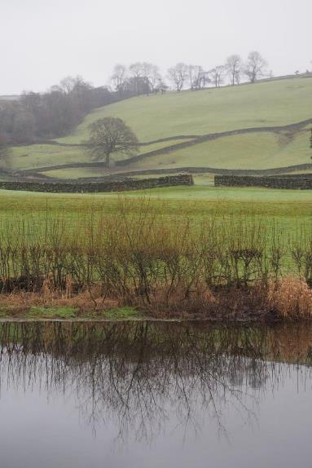
OUR OBJECTIVES
Reduce the amount of effluent discharged into the River Kent from a variety of sources
2. Ensure that wastewater treatment facilities meet:
current needs
the needs of new housing development
the additional pressures which will result from climate change
3. Work with people and organisations who use the river
4. Work with local councils, organisations and potential funders
5. Protect the ecology and wildlife of the River Kent

Slide 4
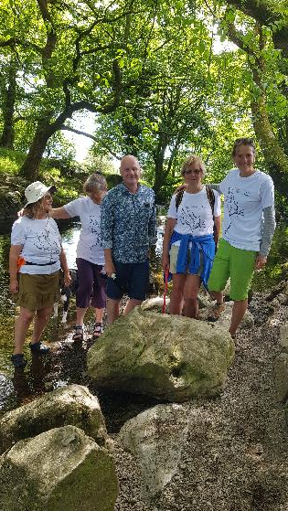
2022 – BUILDING THE CAMPAIGN
Established CRKC Facebook page (@cleanriverkent) & created website http://www.sustainablestaveley.org.uk/clean-up-the-kent/
Monthly newsletter, weekly updates, 2 Open Days & a Training Day
Produced a short introductory film (plus Crowdfunder film) https://www.youtube.com/watch?v=etumaHnGsnA
Created a film, declaring the Rights of the river Kent (https://www.youtube.com/watch?v=BqWAhgleqD0&t=21s)
Raised £7,500 from a variety of funders and crowdfunding appeal

Slide 5
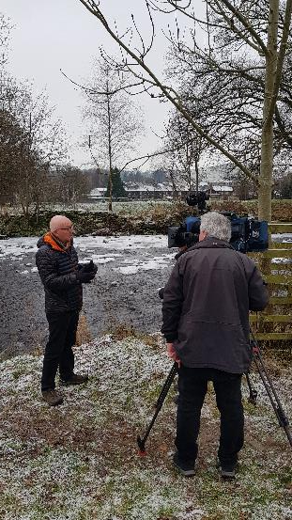
2022 – COMMUNITY ENGAGEMENT
Initiated discussions with United Utilities, but minimal tangible progress so far
Established links with University of Cumbria and worked with research student on River Kent water quality dissertation
Engaged with residents & schools (inc. sessions with Staveley school); recreational groups (inc. Lakeland Canoe Club, Kent (Westmorland) Angling Association); and other local/national campaign groups
Worked with stakeholders (inc. South Cumbria Rivers Trust, Freshwater Biological Association, the Lake District National Park Authority, United Utilities), MPs (including Tim Farron and Jim McMahon) and local Councils
Generated lots of TV, radio & print coverage (national and local) including: BBC North West, ITV Borders, BBC online, Times online, BBC Cumbria, Cumbria Crack, Westmorland Gazette
Notes:
United Utilities – 4 meetings inc visit to Staveley WwTW + they attended Wrap Up event on 21 October and provided “letter of support” for DEFRA application. It has proved difficult to get information for various reasons eg sensors at Staveley WwTW don’t work, so can’t report overspills; all data from 2021 regarded as commercial in confidence because of Ofwat investigation. No progress with requests for information about plans for investment in either WwTW or sewerage infrastructure. UU have now requested a meeting after Water Quality Report published, and have been invited to next CRKC meeting on 21 Feb.

Slide 6
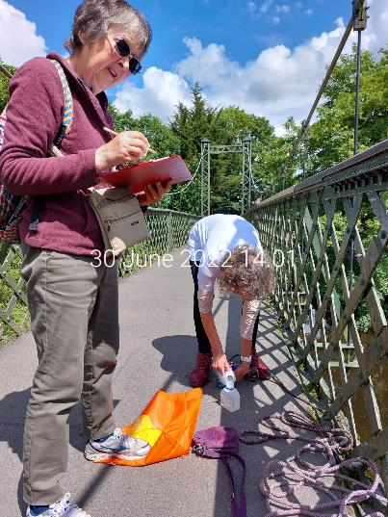
2022 – RECRUITING AND WORKING WITH VOLUNTEERS
Established and supported a network of 100+ volunteers along the River Kent – undertaking a variety of tasks:
river water sampling
surveying river users
completing river diaries
undertaking user counts
analysing statistics
film making
giving talks (e.g. Rotary Club, Town Council, CaBA)
information stands
taking part in events (e.g. river clean up at KMFF)
fundraising
photography
creating artwork
Duke of Edinburgh coursework
media work

Slide 7
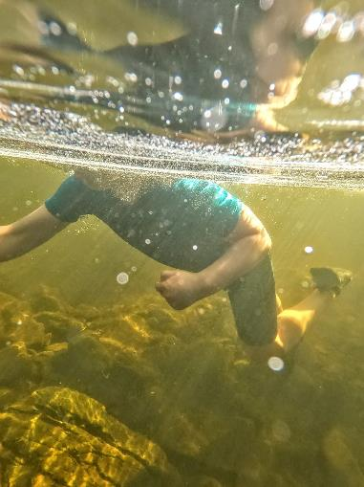
2022 – APPLICATION TO DEFRA FOR BATHING STATUS AT STAVELEY RECREATION GROUND
Application to DEFRA for bathing water status for stretch of river in Staveley (awaiting results): STAVELEY-BATHING-DESIGNATION-APPLICATION-CRKC.26.10.22-.pdf
This application included:
The case for bathing status
The analysis of 308 completed surveys to assess the level of support for bathing status
Counts of people using the river from May through to September – paddling, swimming, kayaking, angling and walking
Letters of support for the application, including from landowners, the Lake District National Park, local councils, and the South Cumbria Rivers Trust

Slide 8
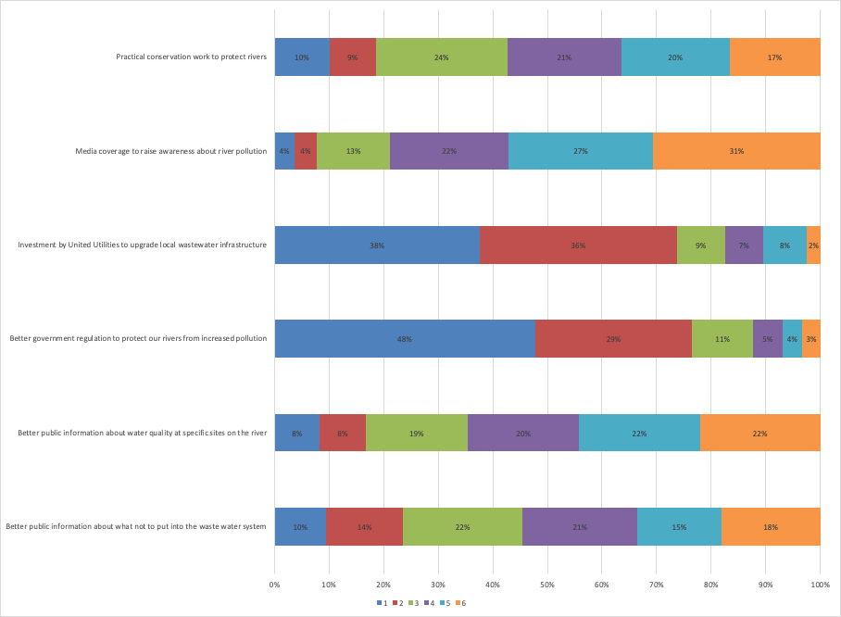
SUMMER SURVEY
RESULTS
Practical conservation work to protect rivers
Q 5 Please rank how important you think the following are (1 = most important)
Media coverage to raise awareness about river pollution
Investment by UU to upgrade wastewater infrastructure
1 = Dark Blue
2 = Red
3 = Green
4 = Purple
5 = Turquoise
6 = Orange
Better government regulation to protect our rivers from increased pollution
Better public information about water quality at specific sites
Better public information about what not to put into the waste water system
xxxx
Notes:
Collected useful information about river Kent users attitudes and concerns about the river.
Key that most people (over three-quarters were in the 1 and 2 category) thought we should be targeting UU and Environment agency and other gov bodies

Slide 9
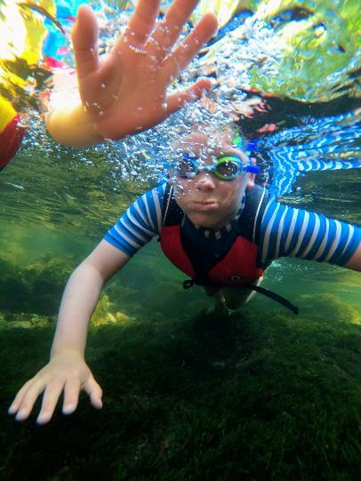
2022 – RIVER WATER QUALITY MONITORING
Ilkley Clean River Group obtained bathing status for the River Wharfe in 2020, the first river in England to achieve this
As part of their campaign they tested the river water for faecal bacteria and we decided to do the same
Pilot monitoring (Spring 2022) informed systematic monitoring through the bathing season (May to Sept 2022) testing each of 67 samples for E.coli and Enterococcus Spp in an accredited laboratory (ALS)
This unique dataset provides an assessment of water quality at 6 sites along the River Kent: CRKC-Results-of-River-Water-Sampling-FINAL.December-22.pdf

Slide 10
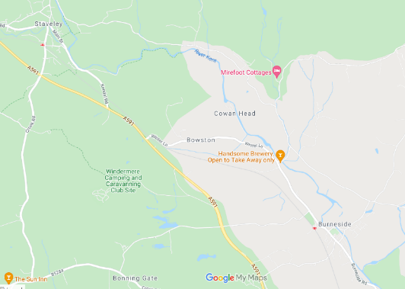
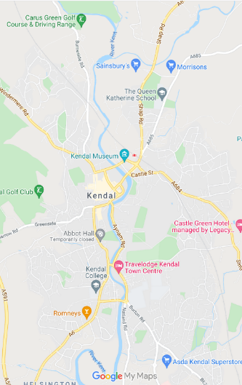
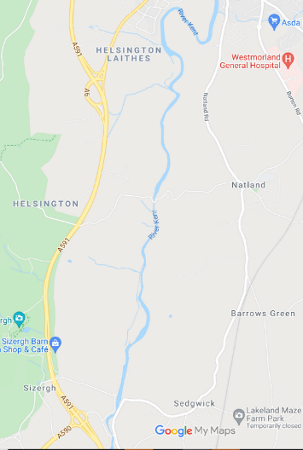
WATER QUALITY MONITORING (February to September 2022)
SITE 1
Staveley Recreation Ground
Site 2
Beckmickle Ing
SITE 3
Burneside Millennium Green
Site 4 - Dockray Hall Bridge (Sandy Bottoms), Kendal
SITE 5 - Hawes Bridge, Natland
Site 6
Sedgwick
= Wastewater Treatment Works

Slide 11
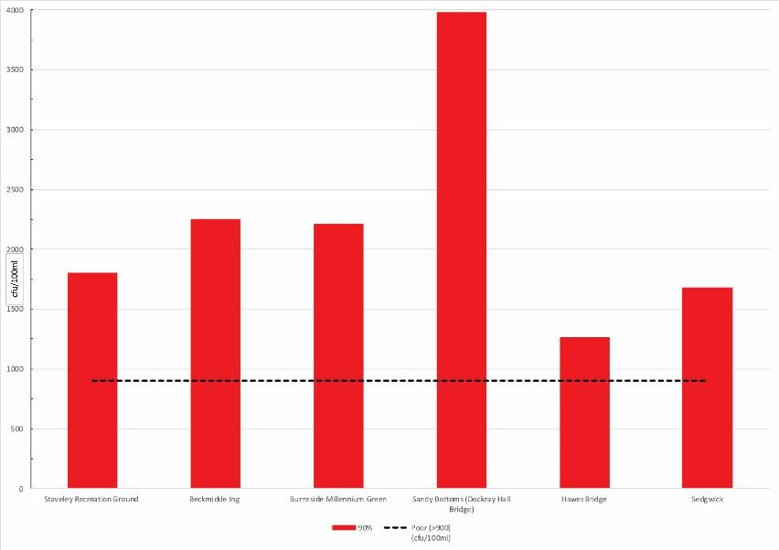
WATER QUALITY TESTING RESULTS – E.coli
Graph showing the 90th percentile for E. coli levels at each monitoring location.
The black line indicates a level of >900 colony forming units cfu/100ml; levels above this are regarded as Poor/Unsatisfactory.
Notes:
Both E. coli and Enterococcus are bacteria found in the gut of humans and other animals, which can cause disease in humans. The results for both show that at every location the levels were unacceptably High, and would be rated by the Environment Agency as Poor. The pattern is slightly different but more detailed studies would be needed to explore whether this is significant.

Slide 12
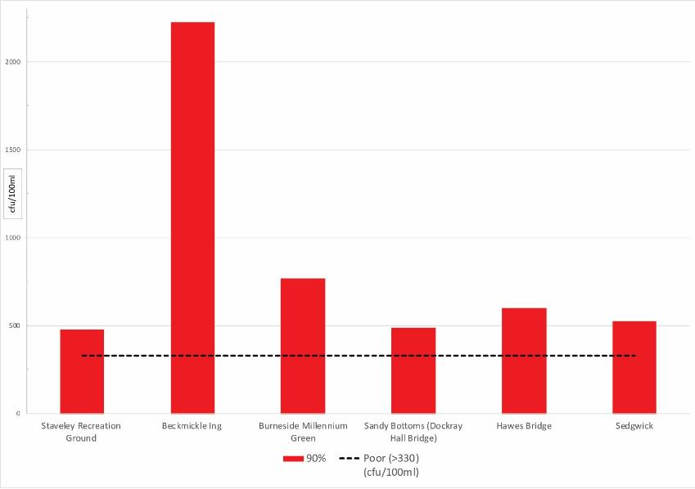
WATER QUALITY TESTING RESULTS - Enterococcus spp
Graph showing the 90th percentile for Enterococcus spp levels at each monitoring location.
The black line indicates a level of >330 colony forming units cfu/100ml; levels above this are regarded as Poor/Unsatisfactory.
Notes:
Both E. coli and Enterococcus are bacteria found in the gut of humans and other animals, which can cause disease in humans. The results for both show that at every location the levels were unacceptably High, and would be rated by the Environment Agency as Poor. The pattern is slightly different but more detailed studies would be needed to explore whether this is significant.

Slide 13
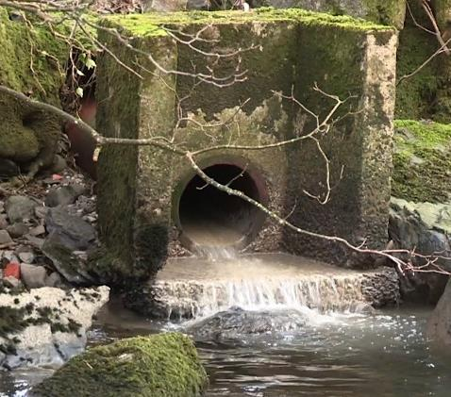
Further Water Quality Monitoring
In parallel with our work volunteers co-ordinated by Staveley with Ings Parish Council monitor discharges from Staveley WwTW
138 observations between 25th Feb - 2nd Dec 2022
“Dump pipe” discharged 74/138 times (54%), most frequently when the weather was wet, and every day (35/61) when an observation was made in October and November
“Treated pipe” discharged 113/136 times (85%) through spring and summer (even though the weather was unusually dry)
University of Cumbria dissertation on water quality showed pollution much higher below than above Staveley WwTW

Slide 14
2023 Plans: ACTIONS (proposed)
Practical citizen science projects with our volunteer group
Build on 2022 microbiological testing project to create a 2023 Citizen Science Programme based on scientific advice, effective training, clear protocols, and systematic data analysis and interpretation
Work in collaboration with local farmers, recreational groups including angling and canoeing/kayaking communities and other individuals and groups involved with the river Kent
Genetic testing to understand the sources of pollution – to what extent is this human and to what extent other animals?
Work with FreshWater Watch (a global Earthwatch citizen science programme) to extend our reach e.g to also include tributaries of the river Kent and/or further south towards Morecambe Bay
Work with South Cumbria Rivers Trust on their Riverfly monitoring programme and with the Freshwater Biological Association on their habitat protection project
Strengthen our established links with the Universities of Cumbria and Lancaster through developing joint projects.
Notes:
Citizen science projects are a key part of our work programme in 2023, actively engaging our network of volunteers in valid, useful research.
We will ensure that our work also adds value to programmes being undertaken by local conservation and environmental organisations.
It will contribute to our growing body of evidence along the river Kent, building on the 2022 results.

Slide 15
2023 Plans: ACTIONS (proposed)
More visible and effective local campaigning
We have worked hard to engage with local people and organisations – we will build on this in 2023
A new focus will be the new Westmorland and Furness Council from 1 April 2023
Continue to strengthen partnerships with wide range of partners including: parish and town councils, the Lake District National Park Authority, the South Cumbria Rivers Trust, the Freshwater Biological Association, Natural England, Cumbria Wildlife Trust and others
A priority will be to hold United Utilities to account for their responsibility to manage wastewater in the best interests of wildlife and of those who enjoy water-based leisure pursuits
Support partners, including the Environment Agency, in pressing for urgent investment in both wastewater treatment works and sewerage infrastructure within PR24 and AMP25
Work with media partners to create and publicise local campaigning (some linked to national campaigns) based on a media strategy including eye-catching initiatives, and working with children and young people
Notes:
Worth also stating that the proposed new Gov bill doesn’t address these issues adequately

Slide 16
2023 Plans: ACTIONS (proposed)
Developing stronger networks of local organisations within Cumbria and beyond
Build on, and extend, our growing local network of similar “freshwater groups” to:
Learn from each other and share expertise, avoid mistakes, create a larger shared voice
Co-ordinate local events/campaigns to amplify impact – and, as part of this, work more effectively across Cumbria
Undertake practical activities in collaboration with other groups e.g. litter picks; Open Days; Riverfly monitoring
Work alongside leading-edge organisations across the UK to learn from them, and to coordinate activities on a national basis
Consult with national groups eg. Fish Legal on how we can contribute to any legal action to protect rivers / challenge polluters
Use our local ‘case studies’ to inform national campaigns

Slide 17
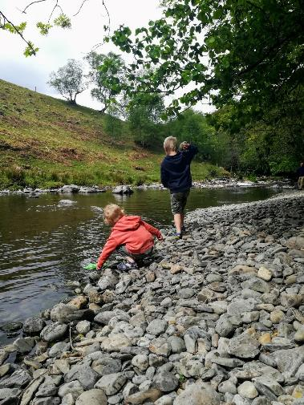
2023 Plans: BUDGET
Programme co-ordination – inc. volunteer support, newsletters, social media, PR, meetings, training, events, room hire, printing, refreshments, equipment
Practical citizen science projects / volunteer activities – inc. FreshWaterWatch, South Cumbria Rivers Trust and the Freshwater Biological Association conservation work; clean-up days with partners
Genetic testing – in collaboration with the University of Lancaster
Partnership working and campaigning – Local & national networking, information sharing, stakeholder engagement
We may be launching a crowdfunder, and are currently approaching foundations & partners for contributions with a publicity leaflet including details of how to donate
Funds received so far for 2023:
£4,195.79 from South Lakeland District Council, Staveley with Ings Parish Council, Burneside Parish Council, Community Lottery via SENS, plus carry forward from 2022
Applications outstanding include:
Burneside Community Energy - tbc £500
Patagonia - tbc application made for £6,000 for genetic testing (will know by May)
Applications to be made to other organisations including CAfS and the Lake District Foundation

